Slide 1
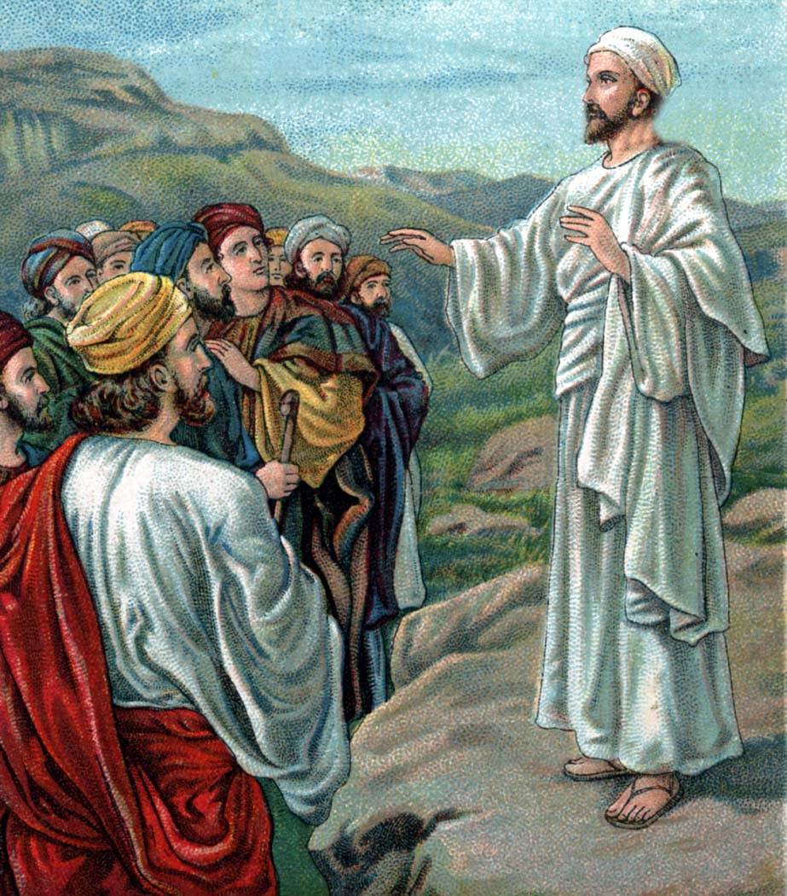
THE LIFE OF CHRIST
PART 29

Slide 2
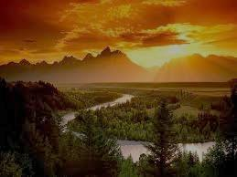
Matthew 6:25 " Therefore I say to you, do not worry about your life, what you will eat or what you will drink; nor about your body, what you will put on. Is not life more than food and the body more than clothing?

Slide 3
Matthew 6:26 "Look at the birds of the air, for they neither sow nor reap nor gather into barns; yet your heavenly Father feeds them. Are you not of more value than they?

Slide 4
Matthew 6:27 "Which of you by worrying can add one cubit to his stature?

Slide 5
Matthew 6:28 "So why do you worry about clothing? Consider the lilies of the field, how they grow: they neither toil nor spin; ²⁹ "and yet I say to you that even Solomon in all his glory was not arrayed like one of these. ³⁰ "Now if God so clothes the grass of the field, which today is, and tomorrow is thrown into the oven, will He not much more clothe you, O you of little faith? ³¹ "Therefore do not worry, saying, 'What shall we eat?' or 'What shall we drink?' or 'What shall we wear?' ³² "For after all these things the Gentiles seek. For your heavenly Father knows that you need all these things.

Slide 6
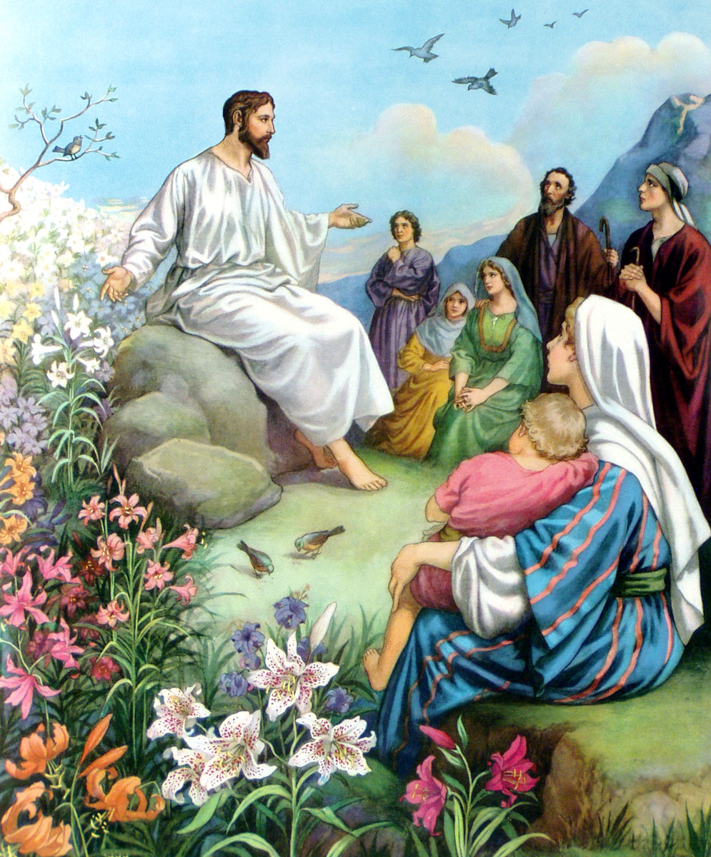

Slide 7
Philippians 4:10 But I rejoiced in the Lord greatly that now at last your care for me has flourished again; though you surely did care, but you lacked opportunity. ¹¹ Not that I speak in regard to need, for I have learned in whatever state I am, to be content: ¹² I know how to be abased, and I know how to abound. Everywhere and in all things I have learned both to be full and to be hungry, both to abound and to suffer need. ¹³ I can do all things through Christ who strengthens me.

Slide 8
Matthew 6:33 "But seek first the kingdom of God and His righteousness, and all these things shall be added to you. ³⁴ "Therefore do not worry about tomorrow, for tomorrow will worry about its own things. Sufficient for the day is its own trouble.

Slide 9
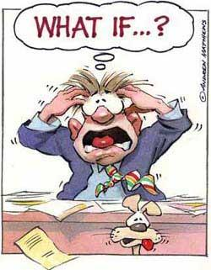
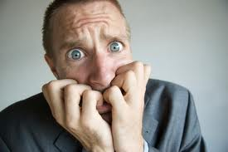
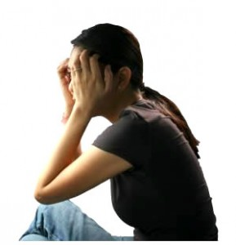
A worrywart is defined as: a person who tends to worry habitually and often needlessly.

Slide 10
1. Worrying can affect your health. Medical experts tell us that prolonged worrying or anxiety can lead to serve physical problems. It can produce (ulcers, headaches, backaches, change of blood pressure, heart attacks, and depression). Worrying can become crippling if it is not properly controlled.

Slide 11
2. Worrying can disrupt our spiritual productivity. When worries consume our thoughts, we tend to focus only on those worries. By doing this, we tend to leave the Lord and His will out of our lives. We find little time for prayer or Bible study; and it will lead to a reduced interest in assembling with the saints.

Slide 12
3. In (Phil. 4:6ff), Paul explains that if we worry too much, then God’s peace that He offers to us will diminish.
4. Worrying affects the way we treat others. When we worry a lot, we tend to be harsher towards our family, friends, and co-workers. We get so wrapped up in our worries that we lash out at those we love the most.

Slide 13
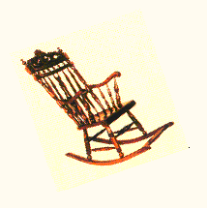
“Worrying is like a rocking chair; it will give you something to do, but it won’t get you anywhere.”

Slide 14
Philippians 4:6 Be anxious for nothing, but in everything by prayer and supplication, with thanksgiving, let your requests be made known to God; ⁷ and the peace of God, which surpasses all understanding, will guard your hearts and minds through Christ Jesus.

Slide 15
1 Peter 5:6 Therefore humble yourselves under the mighty hand of God, that He may exalt you in due time, ⁷ casting all your care upon Him, for He cares for you.
Psalm 55:22 Cast your burden on the LORD, And He shall sustain you;

Slide 16
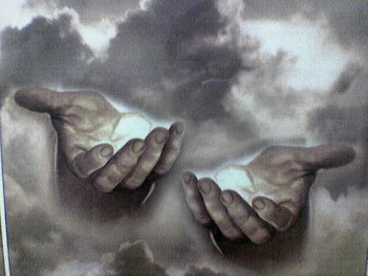

Slide 17
Acts 9:36 At Joppa there was a certain disciple named Tabitha, which is translated Dorcas. This woman was full of good works and charitable deeds which she did.

Slide 18
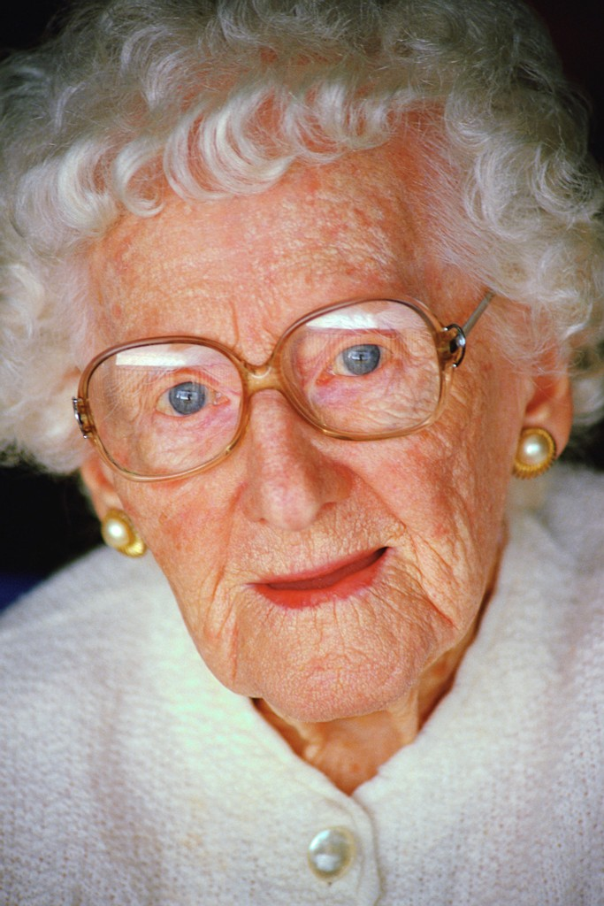

Slide 19
Philippians 1:21 For to me, to live is Christ, and to die is gain. ²² But if I live on in the flesh, this will mean fruit from my labor; yet what I shall choose I cannot tell. ²³ For I am hard pressed between the two, having a desire to depart and be with Christ, which is far better.

Slide 20
1. Matthew 6:25 " Therefore I say to you, do not worry about your life, what you will eat or what you will drink; nor about your body, what you will put on. Is not life more than food and the body more than clothing?

Slide 21
Psalm 46:10 Be still, and know that I am God

Slide 22
Romans 8:28 And we know that all things work together for good to those who love God, to those who are the called according to His purpose.

Slide 23
2. Matthew 6:26 "Look at the birds of the air, for they neither sow nor reap nor gather into barns; yet your heavenly Father feeds them. Are you not of more value than they?

Slide 24
Matthew 10:29 "Are not two sparrows sold for a copper coin? And not one of them falls to the ground apart from your Father's will. ³⁰ "But the very hairs of your head are all numbered. ³¹ "Do not fear therefore; you are of more value than many sparrows.

Slide 25
3. Matthew 6:27 And which of you by being anxious can add a single hour to his span of life?

Slide 26
Luke 10: ³⁸ Now it happened as they went that He entered a certain village; and a certain woman named Martha welcomed Him into her house. ³⁹ And she had a sister called Mary, who also sat at Jesus' feet and heard His word. ⁴⁰ But Martha was distracted with much serving, and she approached Him and said, "Lord, do You not care that my sister has left me to serve alone? Therefore tell her to help me." ⁴¹ And Jesus answered and said to her, "Martha, Martha, you are worried and troubled about many things. ⁴² "But one thing is needed, and Mary has chosen that good part, which will not be taken away from her."

Slide 27
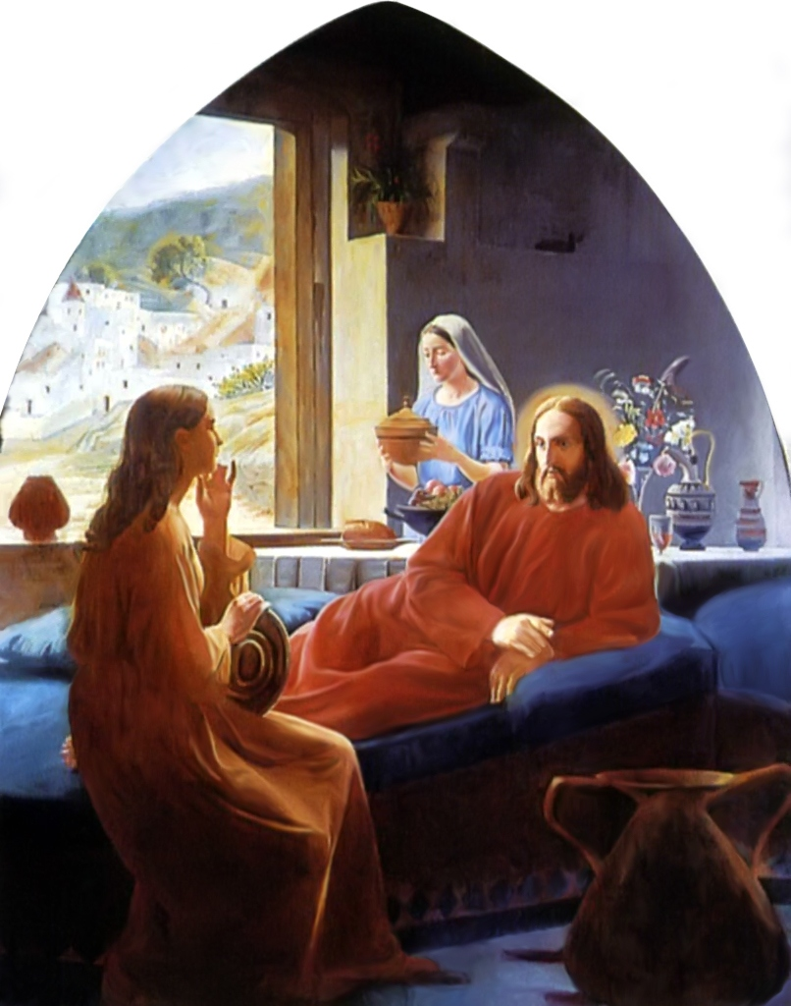

Slide 28
4. Matthew 6:28 "So why do you worry about clothing? Consider the lilies of the field, how they grow: they neither toil nor spin; ²⁹ "and yet I say to you that even Solomon in all his glory was not arrayed like one of these. ³⁰ "Now if God so clothes the grass of the field, which today is, and tomorrow is thrown into the oven, will He not much more clothe you, O you of little faith? ³¹ "Therefore do not worry, saying, 'What shall we eat?' or 'What shall we drink?' or 'What shall we wear?' ³² "For after all these things the Gentiles seek. For your heavenly Father knows that you need all these things.

Slide 29
Matthew 6:33 But seek first the kingdom of God and His righteousness, and all these things shall be added to you.

Slide 30
Matthew 6:34 "Therefore do not worry about tomorrow, for tomorrow will worry about its own things. Sufficient for the day is its own trouble.

Slide 31


